Slide 1
Introduction to Ontologies
Fernando Aguilar Gómez
CSIC (+SKILLS4EOSC fellowship)

Slide 2
Outline
Introduction
Key concepts
Benefits and “types”
Technologies and applications. Examples
Ontology modelling

Slide 3
Intro
What is Knowledge?
Knowledge refers to the awareness, understanding, and interpretation of facts, concepts, or truths that are acquired through learning, experience, or reasoning.
How Humans Conceive Knowledge:
Knowledge is conceptualized through perception, cognition, and abstraction.
Humans interpret reality, organize it into concepts, and create structures to represent relationships and hierarchies.
Forms of Knowledge Representation:
Narrative (Storytelling): Traditional method for passing down knowledge.
Symbols and Language: Using words, signs, and symbols to communicate ideas.
Formal Models: Logical frameworks, such as ontologies, that enable clear, structured representation of complex knowledge.

Slide 4
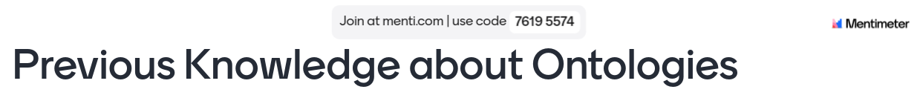

Slide 5
What is an Ontology?
In Computer Sciences: formal representation of a concept or entity. Types, properties, and relationships.
A way to organize information and its interrelations.
Examples: Taxonomy, controlled vocabularies, linked data.
Semantic Web.
Semantic and ontological metadata on the World Wide Web.
Content, meaning, and the relationship of data.
Provided formally. Automatic evaluation by processing machines.
Intelligent agents: information search without human operators.

Slide 6
Ontologies and RDM
How Ontologies Support Research Data Management:
Metadata Annotation: Ontologies provide a standardized way to annotate metadata, making data more discoverable and interoperable.
Data Sharing: Well-defined ontologies enhance data sharing by ensuring that the meaning of data is preserved across platforms.
Compliance with FAIR Principles: Ontologies support the FAIR data principles (Findable, Accessible, Interoperable, Reusable).
Biomedical Research:
The Gene Ontology (GO) used for classifying gene functions.
Environmental Data:
The Environmental Ontology (ENVO) to standardize terms in ecological research.
Example of RDM System:
Ontologies used in data repositories like Dataverse for better classification and retrieval.

Slide 7

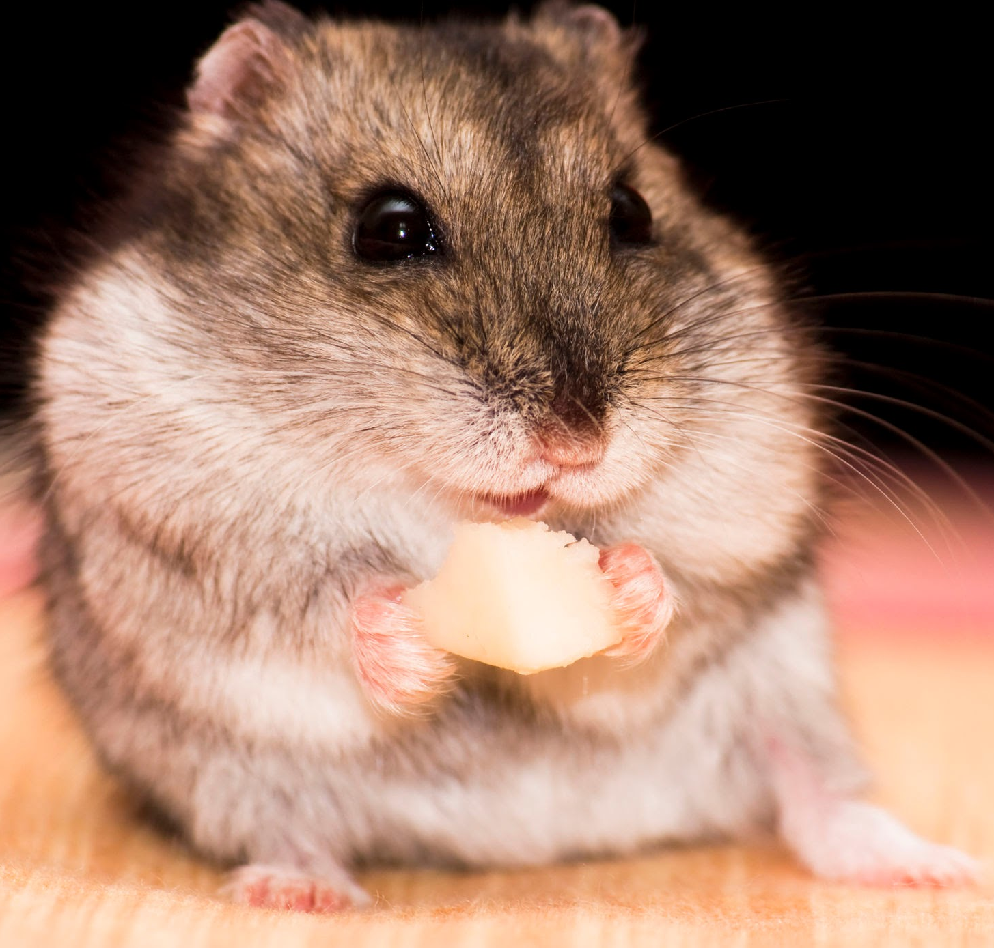


Key Concepts
Class: Hamster
Property: attribute
Classes (Concepts)
Define entities in a domain.
Instances
Concrete examples of classes
Properties:
Attributes: Describe attributes of classes.
Relations: Connections between classes.
isOld
2 years
Instance:
Mickey
Class: City
hasBorn
Instance: Karlsruhe
Property: relation

Slide 8
Classes
A class in an ontology represents a concept or category of things within a domain of knowledge.
Classes are used to group entities (called instances or individuals) that share common characteristics or properties.
Role of a Class:
Organizes Knowledge: Classes define the broad categories that organize the data. For example, in an ontology about animals, "Mammal" could be a class.
Abstract Representation: Classes are abstract and represent a general group of entities rather than specific instances.
Hierarchy and Structure: Classes are often structured in a hierarchy, with subclasses inheriting properties from more general classes (superclasses).

Slide 9
Classes - Example
In a transportation ontology:
Class: “Vehicle”
Subclass: “Car” (inherits properties from "Vehicle")
Instance/Individual: “MyCar” (a specific car that belongs to the class “Car”)
Characteristics of Classes:
Subclass Relationships: Classes can have subclasses that are more specific versions of the class. For example, “Bird” might be a subclass of “Animal.”
Instances: Each class can have instances or individuals that belong to it. For example, “Rex” could be an instance of the class “Dog.”

Slide 10
Instances
An instance (or individual) is a specific, concrete entity that belongs to a class in an ontology.
Instances represent real-world objects, events, or concepts that are categorized under a particular class.
Role of an Instance:
Specific Example of a Class: While classes represent abstract categories (e.g., “Car”), instances represent specific examples of that category (e.g., “MyCar” or “Toyota Corolla”).
Populating the Ontology: Instances bring ontologies to life by populating the abstract framework with real or conceptual entities.

Slide 11
Instances - Example
Class: “Dog”
Instance: “Rex” (a specific dog, belonging to the class “Dog”)
Properties of Rex: "Rex hasColor 'Brown'," "Rex hasAge 3 years"
Characteristics of Instances:
Uniqueness: Each instance is unique within its context (ID). For example, “Rex” refers to a specific dog, different from another instance like “Max.”
Associated with Classes: Every instance must belong to one or more classes. Instances inherit the properties and behaviors defined by the class.
Attributes/Properties: Instances are characterized by specific attributes (e.g., name, age, color) and relationships with other instances.

Slide 12
Properties
A property in an ontology describes a characteristic or a relationship of an instance or between two instances.
Properties are used to define the attributes or relations of a class or an instance.
Types of Properties:
Datatype Properties: These link an instance to a literal value (e.g., a string, number, or date).
Example: “Person hasAge 30” — Here, “hasAge” is a datatype property linking the instance “Person” to the number 30.
Object Properties: These link an instance to another instance or entity.
Example: “Person hasFriend John” — “hasFriend” is an object property linking one person to another individual.

Slide 13
Role of Properties
Describe Characteristics: Properties help describe the attributes or features of instances (e.g., a car’s color or a person’s age).
Define Relationships: They also establish relationships between entities, such as ownership or membership.

Slide 14
Relations
A relation (typically expressed through object properties) in an ontology defines a connection or association between two instances or between an instance and a class.
Relations are the mechanisms through which entities in an ontology are connected, creating a web of interrelated data.
Types of Relations:
Hierarchical Relations: Represent subclass or superclass relationships (e.g., “Dog is a subclass of Animal”).
Non-Hierarchical Relations: Define more general connections, such as one entity owning or being related to another (e.g., "Person owns Car").

Slide 15
Relations - Example
In a family ontology:
Relation: “ParentOf”
Instances: “Alice” (Person), “Bob” (Person)
Description: "Alice ParentOf Bob" — This relation connects two instances, describing that Alice is Bob’s parent.
Role of Relations:
Structure the Data: Relations give structure to the data by defining how instances interact with or relate to one another.
Express Interconnections: They allow the ontology to represent real-world relationships between entities.

Slide 16
Subject - Predicate - Object (I)
The Subject-Predicate-Object structure is a fundamental concept in ontologies, commonly referred to as a triple.
It represents how knowledge is expressed as a statement in the form of three components:
Subject: The entity or instance being described.
Predicate: The property or relationship applied to the subject.
Object: The value or entity to which the subject is related via the predicate.

Slide 17
Subject - Predicate - Object (II)
Breakdown of the Triple:
Subject: The resource or instance about which the statement is made.
Predicate: The property or relation that connects the subject to the object.
Object: The target of the statement, which can be another instance (object property) or a literal value (datatype property).
Role in Ontologies:
This triple structure is used to express facts or knowledge in ontology languages like RDF (Resource Description Framework).
It forms the basis for describing relationships and characteristics in a formal, machine-readable way.

Slide 18
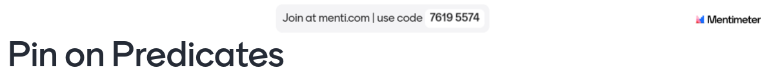

Slide 19
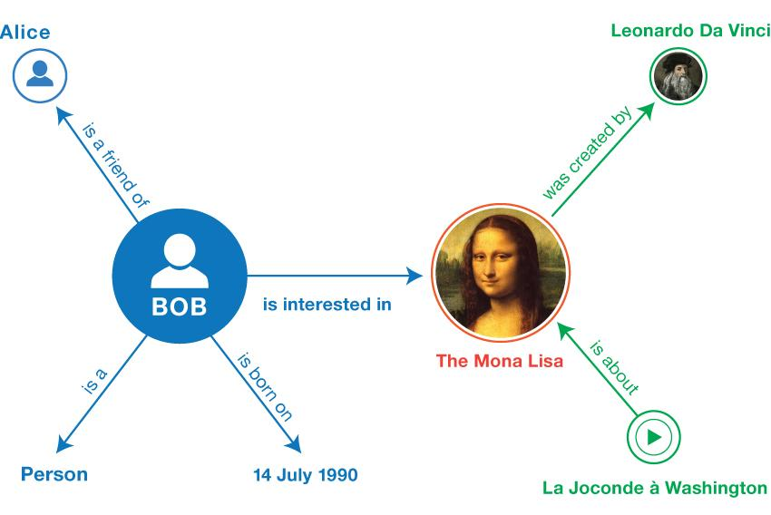
Subject - Predicate - Object (III)
Labeled directed graph
From W3C RDF 1.1. Primer https://www.w3.org/TR/rdf11-primer/

Slide 20
Benefits
Data Interconnection: Facilitates the integration and connection between dispersed datasets, allowing for more comprehensive and enriched access to information on the web.
Interoperability: Promotes interoperability between systems and applications, making it easier to collaborate and exchange data between different entities.
Knowledge Discovery: Enables the discovery of hidden knowledge by linking and relating data from different sources, which can lead to new ideas and significant discoveries.
Access to Structured and Linked Data: Facilitates access to structured and linked data on the web, enabling more accurate and efficient information search.
Data Intelligence: Allows for a deeper understanding of data by providing context and meaning through ontologies and semantic metadata.

Slide 21
Differences
1. Ontology:
Definition: A formal and complex model that represents knowledge as a set of concepts, properties, and relationships between entities.
Purpose: Used to model a domain of knowledge in a structured and machine-readable format, often for reasoning and automated inference.
2. Thesaurus:
Definition: A structured collection of terms that organizes concepts and their relationships, focusing on synonymy and term usage.
Purpose: Provides a controlled vocabulary to support information retrieval, often showing preferred terms, alternative terms, and hierarchical relationships.

Slide 22
Differences
3. Taxonomy:
Definition: A hierarchical structure that categorizes concepts into a parent-child relationship, where broader categories encompass more specific ones.
Purpose: Helps to organize knowledge into a structured format, often used for classification and navigation of information.
4. Controlled Vocabulary:
Definition: A predefined, restricted set of terms used consistently to ensure uniformity in indexing and retrieval of information.
Purpose: Controls the use of terms to maintain consistency in describing concepts, often used in databases, cataloging systems, and metadata schemas.

Slide 23
Differences
Aspect | Ontology | Thesaurus | Taxonomy | Controlled Vocabulary
Structure | Formal, complex (classes, properties, relations) | Organized terms (synonyms, hierarchies) | Hierarchical classification | Simple list or hierarchy
Purpose | Knowledge modeling and reasoning | Enhanced search and indexing | Classification and organization | Consistent term usage
Relationships | Hierarchical & non-hierarchical | Synonyms, broader/narrower terms | Parent-child hierarchy | No or minimal relationships
Flexibility | High (complex constraints, axioms) | Medium (synonyms, associations) | Low (strict hierarchy) | Low (fixed terms)
Use Case | Semantic Web, AI, data integration | Library indexing, databases | File systems, classification | Metadata, databases

Slide 24
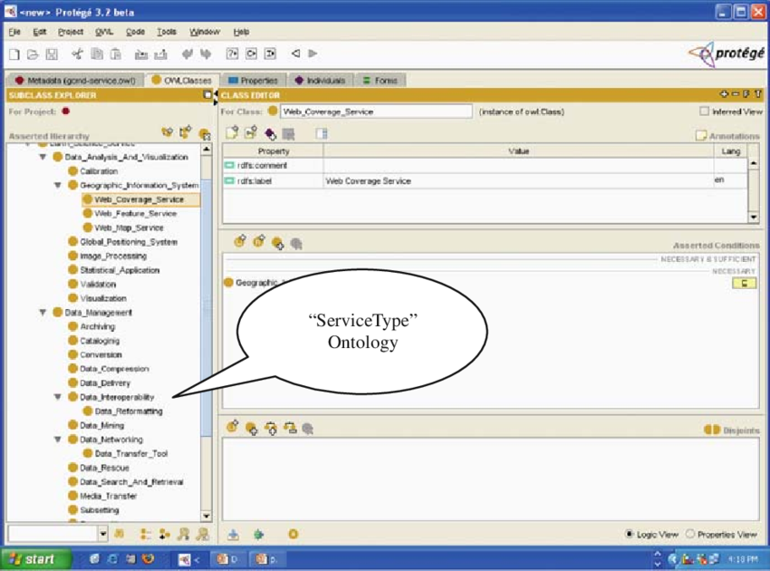
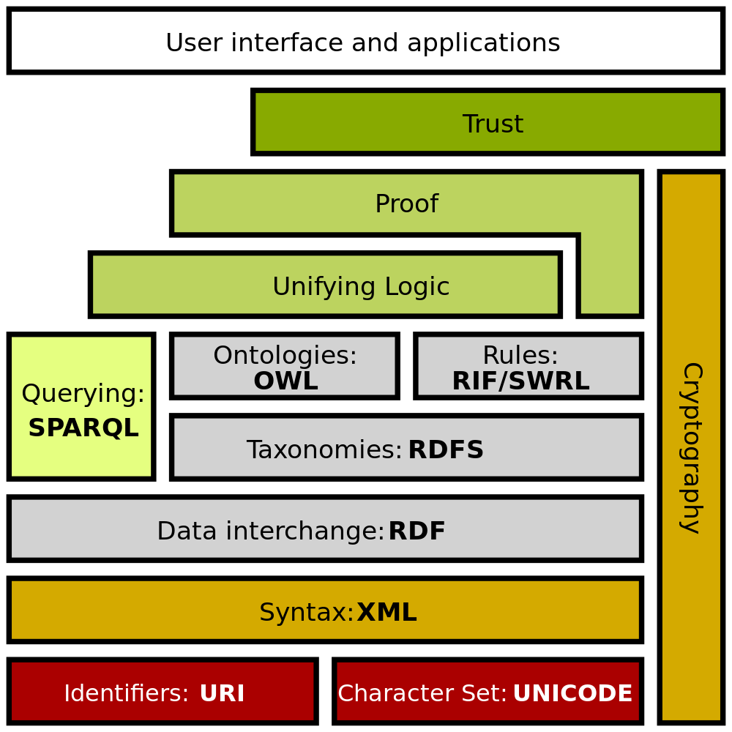

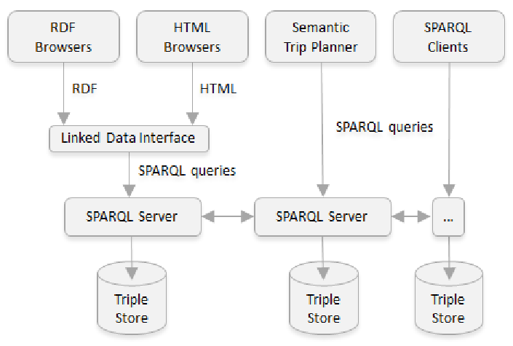
Technologies, Tools

Slide 25
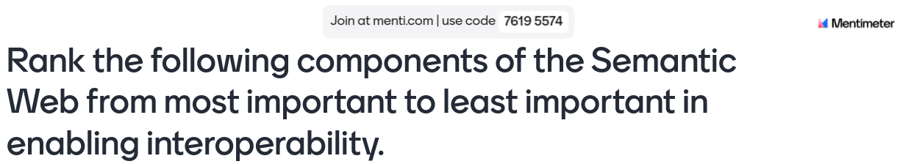

Slide 26
RDF
Resource Description Framework (RDF) by the World Wide Web Consortium (W3C) is a set of specifications originally designed for metadata models. This framework is used to represent data in the LOD (Linking Open Data) cloud, LD, such as XML files and other formats.
To add machine-readable information for search engines.
To enrich a dataset by linking it with third-party datasets.
To provide a data exchange standard between databases.
To allow cross-dataset queries within an organization.
<Bob> <is a> <person>.
<Bob> <is a friend of> <Alice>.
<Bob> <is born on> <the 4th of July 1990>.
<Bob> <is interested in> <the Mona Lisa>.
<the Mona Lisa> <was created by> <Leonardo da Vinci>.
<the video 'La Joconde à Washington'> <is about> <the Mona Lisa>.

Slide 27
SKOS
SKOS (Simple Knowledge Organization System) is a standard used for representing knowledge organization systems (KOS) such as:
Thesauri
Taxonomies
Subject Heading Systems
Controlled Vocabularies
It is part of the Semantic Web technologies and is built using the RDF (Resource Description Framework) model.
Purpose of SKOS:
Simplifies Knowledge Representation: SKOS provides a lightweight framework to model hierarchical and associative relationships between concepts, making it easier to manage structured knowledge.
Facilitates Interoperability: SKOS ensures that different knowledge organization systems can be shared, integrated, and reused across systems and domains.

Slide 28
SKOS - Key components
Concept: Represents a unit of thought, a class, or a category.
Example: "Dog" as a concept in an animal taxonomy.
Labels: Human-readable terms associated with concepts.
Preferred Label (skos): The main term for a concept (e.g., “Dog”).
Alternate Label (skos): Synonyms or alternative terms (e.g., “Canine”).
Hidden Label (skos): Terms used for search but not displayed (e.g., a misspelled version of "Dog").
Relationships:
Broader (skos): Defines a more general concept (e.g., "Animal" is broader than "Dog").
Narrower (skos): Defines a more specific concept (e.g., "Golden Retriever" is narrower than "Dog").
Related (skos): Links concepts that are related but not hierarchically (e.g., “Dog” and “Pet”).
Notes: Used for additional documentation.
Definition (skos): Provides a formal definition of the concept.

Slide 29
Applications
Production of new data
Planning, documentation. MA-DMPs
Learning from similar projects
Optimize reuse
Web of FAIR data and services
Semantic metadata: Ontologies
Connection between data systems. Repositories, portals
Relationship between life cycle components
Notes:
Aparte de la adquisición de datos nuevos, que podemos mejorar documentando correctamente cada proyecto o caso de uso, es decir, aprender de otros casos de uso similares, un punto importante para mejorar la eficiencia del desarrollo científico es la reutilización de datos existentes. Con el concepto de Web of FAIR data and services…

Slide 30
Topic
Name
Description
isRelatedTo
Project
Software
belongsTo
Dataset
isAccessedBy
isGeneratedFrom
implements
isProcessedBy
Instrument
Type
Algorithm
Notes:
Multilenguaje
monitorizr problemas

Slide 31
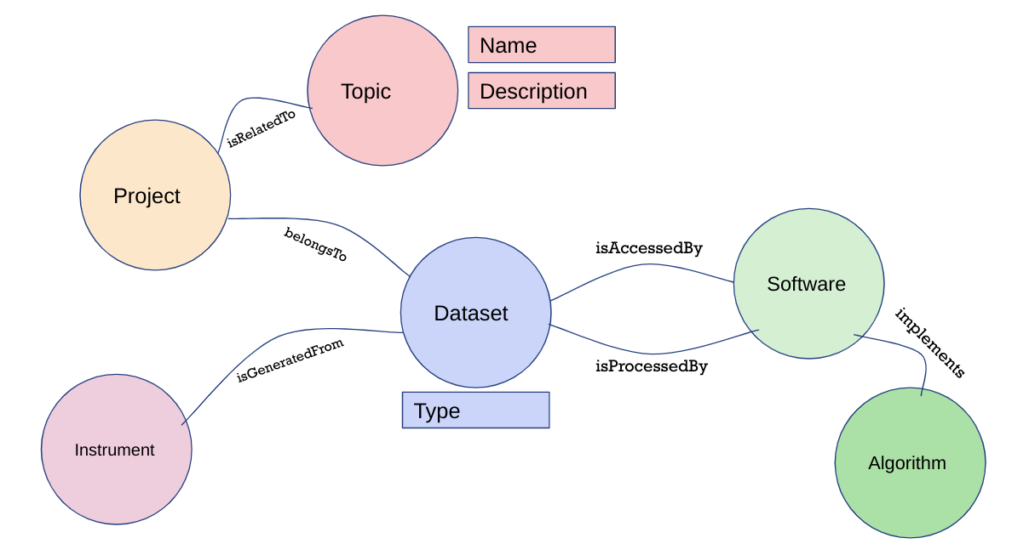
Queries (I)
What other image type datasets have been used in food related projects?
Notes:
Inferencias
https://content.iospress.com/articles/ai-communications/aic210172

Slide 32
Queries (II)
What algorithms have been used in analysis involved in the processing of images taken by the sentinel-2 instrument?
Notes:
Inferencias
https://content.iospress.com/articles/ai-communications/aic210172

Slide 33

Notes:
Inferencias
https://content.iospress.com/articles/ai-communications/aic210172

Slide 34

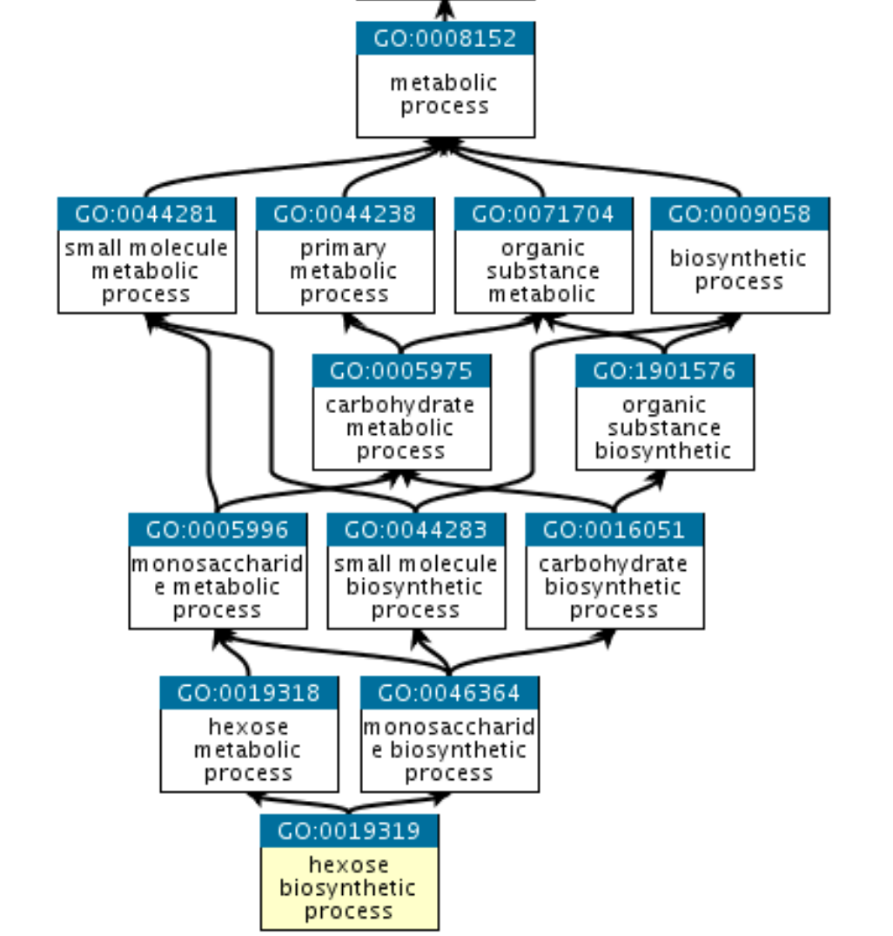
Applications (I)
The Gene Ontology (GO) knowledgebase is the world’s largest source of information on the functions of genes. This knowledge is both human-readable and machine-readable, and is a foundation for computational analysis of large-scale molecular biology and genetics experiments in biomedical research.
https://geneontology.org/

Slide 35
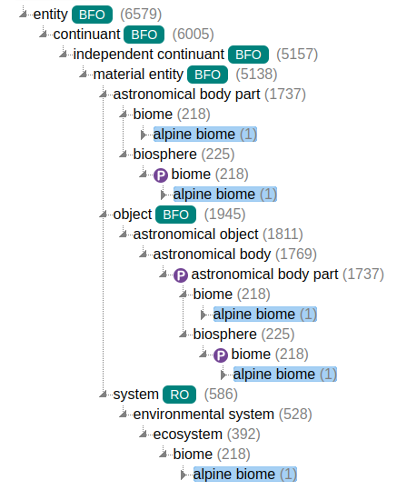

Applications (II)
ENVO is an expressive, community ontology which helps humans, machines, and semantic web applications understand environmental entities of all kinds, from microscopic to intergalactic scales. As a FAIR-compliant resource, it promotes interoperability through the concise, controlled description of all things environmental.
https://sites.google.com/site/environmentontology/

Slide 36
Ontology modelling (I)
Class: Hamster
Protégé
Java tool for modelling ontologies
Start by scratch?
Reuse ontologies if possible
Simple one
Property: attribute
isOld
2 years
Instance:
Mickey
Class: City
hasBorn
Instance: Karlsruhe
Property: relation

Slide 37
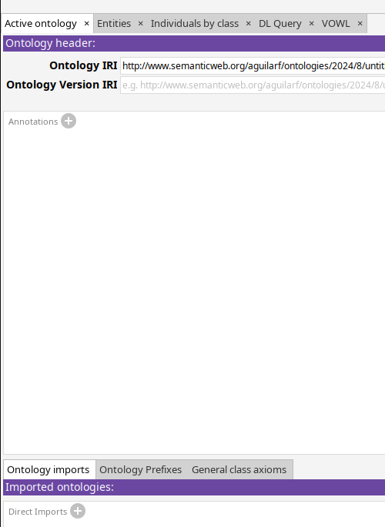
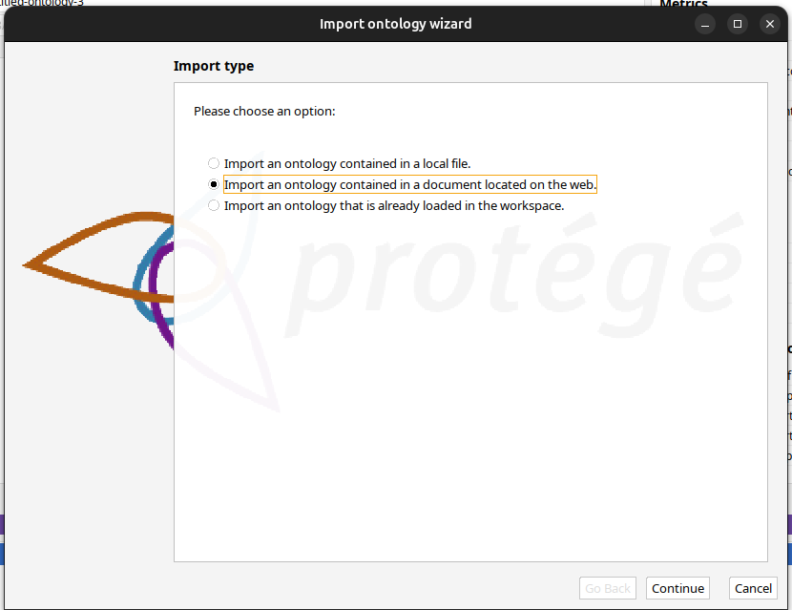
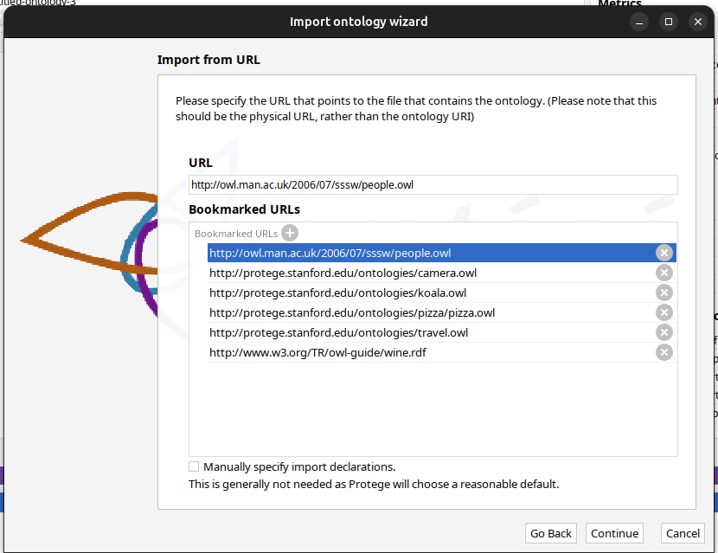
Ontology modelling (II)

Slide 38
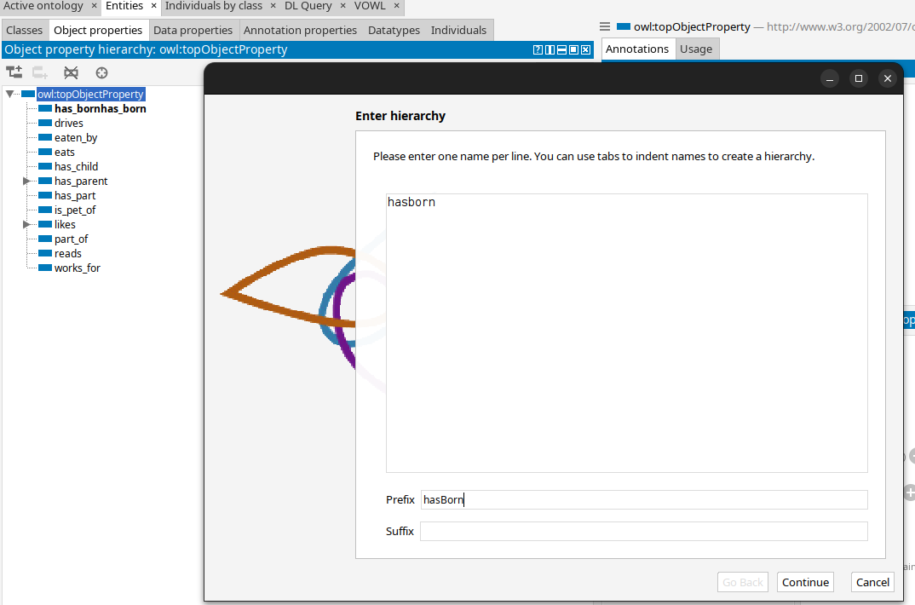
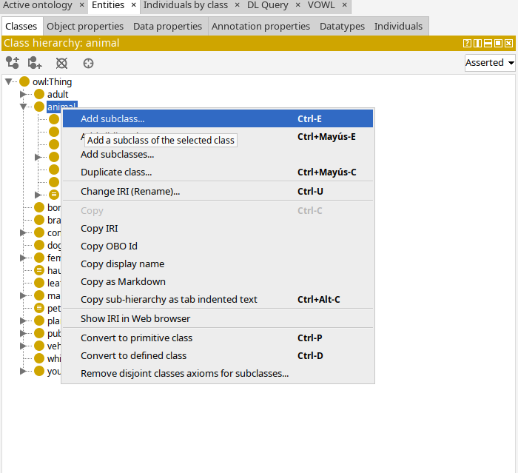
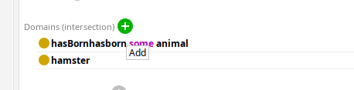
Ontology modelling (III)

Slide 39
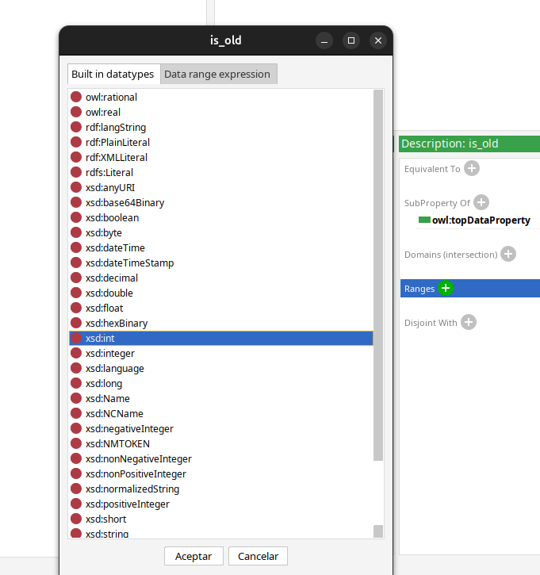
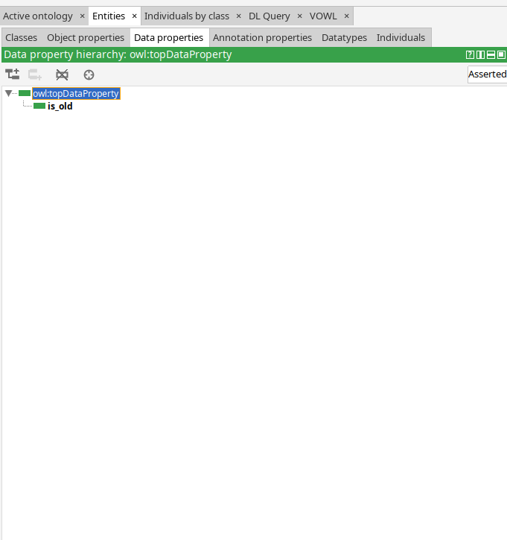
Ontology modelling (IV)

Slide 40
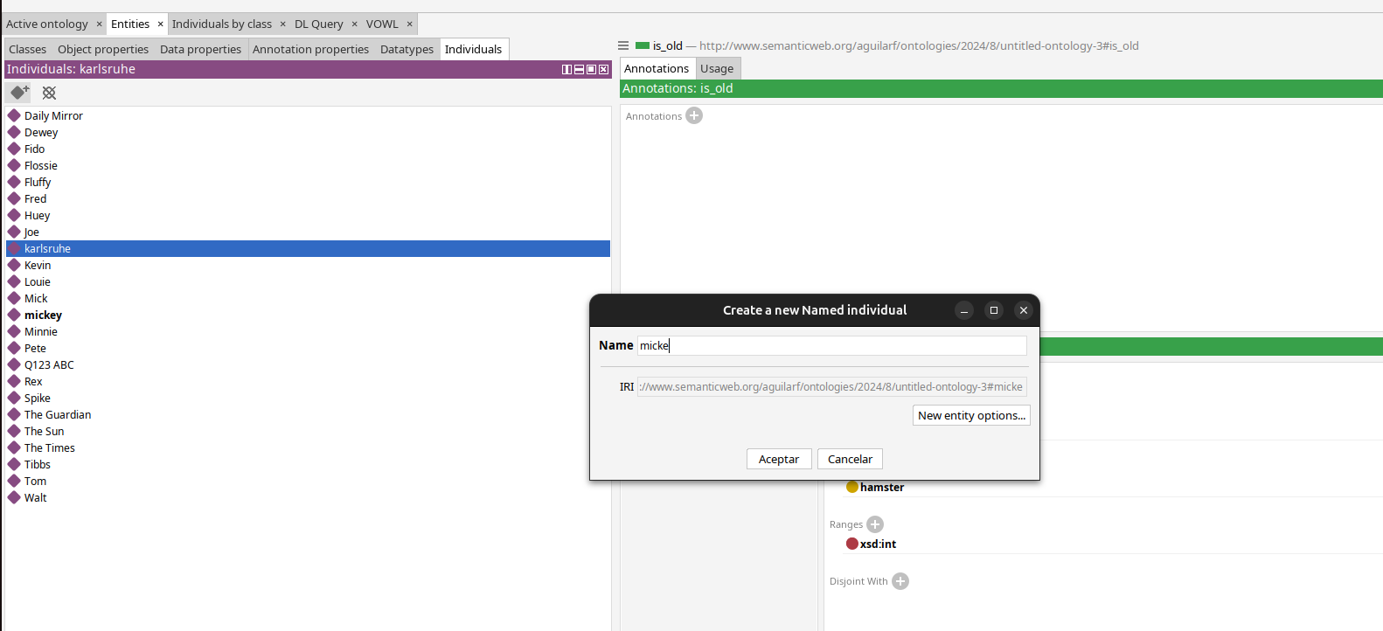
Ontology modelling (V)

Slide 41
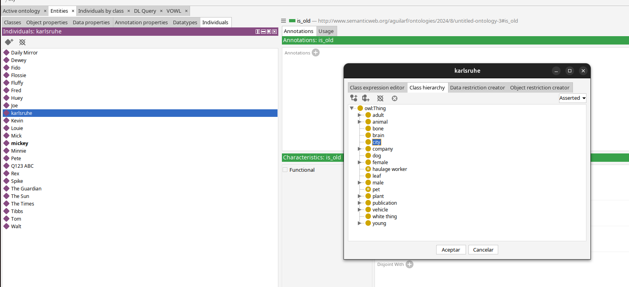
Ontology modelling (V)

Slide 42
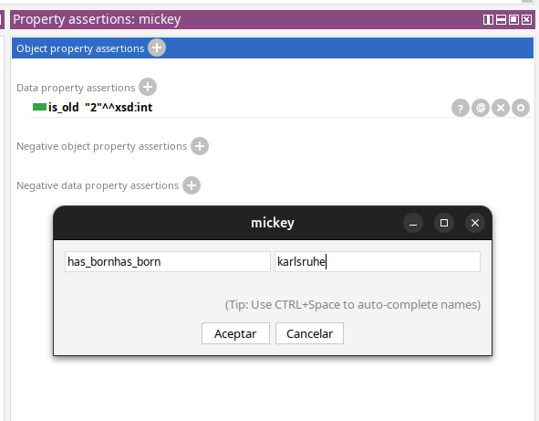
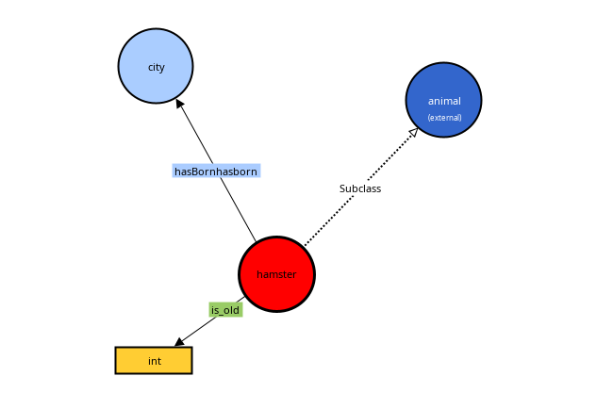
Ontology modelling (VI)

Slide 43
Examples/Links
Dublin Core RDF
https://www.dublincore.org/specifications/dublin-core/dc-rdf/
FAIR Data Points
https://www.fairdatapoint.org/
Google Knowledge Graph
https://developers.google.com/knowledge-graph/
Facebook graph:
https://developers.facebook.com/docs/graph-api/overview/
Wikidata: https://www.wikidata.org/wiki/Wikidata:Main_Page
Freebase
Dbpedia
https://wiki.dbpedia.org/

Slide 44
Summary
Ontology: formal way to represent knowledge
Concepts: Class, Instance, Properties
Triple: Subject - Predicate- Object
Ontologies based on logical structures
Vs. Taxonomy, Thesauri, Controlled Vocabularies
Developing Ontologies
Taking into account existent resources

Slide 45
Thank you! Questions?
Fernando Aguilar Gómez
f.a [at] CSIC.es
To cite this presentation, please copy and paste: <Surname, Name. (Date). Pres title, occasion of the presentation. Link to presentation in Skills4EOSC community on Zenodo>

